Slide 1
Operator Overloading
Chp13 till page 915 from DS Malik C++ prgramming

Slide 2
Introduction
Use operators with objects (operator overloading)
To add two objects, we can make a function, and call it like
Object3 = add(object1,object2);
object3 = object1.add(object2);
With Operator Overloading, we can use the following concise notation
object3 = object2 + object1;

Slide 3
Operator Overloading
Operators such as =, +, and others can be redefined for use with objects of a class
Cannot create new operators
The name of the function for the overloaded operator is operator followed by the operator symbol, e.g.,
operator+() is function to overloaded + operator
operator=() is function to overloaded = operator

Slide 4
Overloading + Operators
A binary operator overloaded as member function needs only one parameter, which represents the operand on the right:
class OpClass
{
private:
int x;
public:
OpClass operator+(OpClass right);
};
Notes:
See pr11-09.cpp, overload.h, and overload.cpp

Slide 5
Overloading Operators as Instance Members
The left operand of the overloaded binary operator is the calling object
The implicit left parameter is accessed through this pointer
OpClass OpClass::operator+(OpClass r)
{ OpClass sum;
sum.x = x + r.x;
return sum;
}

Slide 6
Invoking an Overloaded Operator
Operator can be invoked as a member function:
OpClass a, b, s;
s = a.operator+(b);
It can also be invoked in the more conventional manner:
OpClass a, b, s;
s = a + b;
Notes:
See feetinch2.h, feetinch2.cpp, pr11-10.cpp

Slide 7
Number of Arguments for operator overloading
mystring operator+(mystring b)
Don’t we need two arguments?
Answer: No, the other operand is the object calling this “operator+” member function
Rule:
An overloaded operator always requires one less argument than its number of operands, since one operand is the object of which the operator function is a member
Notes:
Robert Lafore, page 330, 4th Ed
In class Distance the declaration for the operator+() function looks like this:
Distance operator + ( Distance );
This function has a return type of Distance, and takes one argument of type Distance.
In expressions like
dist3 = dist1 + dist2;
it’s important to understand how the return value and arguments of the operator relate to the
objects. When the compiler sees this expression it looks at the argument types, and finding
only type Distance, it realizes it must use the Distance member function operator+(). But
what does this function use as its argument—dist1 or dist2? And doesn’t it need two arguments,
since there are two numbers to be added?
Here’s the key: The argument on the left side of the operator (dist1 in this case) is the object
of which the operator is a member. The object on the right side of the operator (dist2) must
be furnished as an argument to the operator. The operator returns a value, which can be assigned or used in other ways; in this case it is assigned to dist3. Figure 8.2 shows how this looks.
In the operator+() function, the left operand is accessed directly—since this is the object of
which the operator is a member—using feet and inches. The right operand is accessed as the
function’s argument, as d2.feet and d2.inches.

Slide 8
Example- Adding Objects
Distance class
Distance d1,d2,d3;
d3 = d1 + d2;

Slide 9
Distance class
#include <iostream>
using namespace std;
class Distance{
private:
int feet;
float inches;
public:
Distance operator+(Distance);
Distance(int a, float b)
{ feet = a; inches = b;}
void getInput(){
cout<<"Enter feet "; cin>>feet;
cout<<"Enter inches"; cin>>inches;
}
void showdist(){
cout<<feet<<" "<<inches<<endl;
}
};

Slide 10
Operator+ member function
Distance Distance::operator+(Distance b)
{
Distance ans(0,0);
ans.feet = feet + b.feet;
ans.inches = inches + b.inches;
return ans;
}
int main()
{
Distance x(5,3), y(7, 5) , z(0,0);
z = x + y;
//z = x.operator+(y);
z.showdist();
return 0;
}

Slide 11
Operator+ as a nonmember function
Distance operator+(Distance a, Distance b)
{
Distance ans(0,0);
ans.setfeet(a.getfeet() + b.getfeet());
ans.setinches(a.getinches() + b.getinches());
return ans;
}
int main()
{
Distance x(5,8), y(7, 5) , z(0,0);
z = x + y;
//z = operator+(x,y);
z.showdist();
return 0;
}

Slide 12
Friend function
Any function declared as friend in a class can access its data members directly
class Distance
{
int feet;
float inches;
public:
friend Distance operator+(Distance, Distance);
. . . .
Notes:
Friend function can be declared as private or public without any difference, lafore page 521

Slide 13
Operator+ as friend function of Distance class
Distance operator+(Distance a, Distance b)
{
Distance ans(0,0);
ans.feet = a.feet + b.feet;
ans.inches = a.inches + b.inches;
return ans;
}

Slide 14
+=
a, b
a+=b

Slide 15
Operator+= member function
void operator+=(Distance b)
{
feet = feet + b.feet;
inches = inches + b.inches;
//return *this;
}

Slide 16
this pointer
Every object of a class maintains a (hidden) pointer to itself, and the name of this pointer is this
A member function of a class can (directly) access the member variables of that class for a given object.
Sometimes, it is necessary for a member function to refer to the object as a whole, rather than the object’s individual member variables.

Slide 17
Distance class
Overloading <, >, ==, != , * is your homework
If( a < b)
Cout<<“a is less than b”
<=
>=

Slide 18
Operator Overloading with objects of different classes
Till now, we have overloaded operators to work with objects of same classes,
but its also possible to work with objects of different classes.
Example: Adding Distance and mDist
class Distance
{
float feet;
. . . .
class mDist
{
float meter;
. . . .

Slide 19
Operator overloading with different objects
class Distance
{
float feet;
. . . .
class mDist
{
float meter;
. . . .
main()
{
Distance d(4,1),res;
mDist md(8,4);
res = d + dm;

Slide 20
Overloading as non-member and as a member function
Distance operator+(Distance a, mDist b)
{
Distance Distance::operator+(mDist b)
{

Slide 21
Overloading << and >>
To input and output distances into distance class, we defined getdist() and showdist() functions
What if we would like to use << operator to show the distance, and
Similarly >> to input a distance
Distance d1;
d1.getInput();
d1.showdist();
Distance d1;
cin>>d1;
cout<<d1

Slide 22
Overloading <<
cout<< d1;
<< is a binary operator,
Left operand is cout object (of type ostream)
Right operand is d1 object (of type Distance)
This overloaded function can NOT be a member function, WHY?
as the left operand belongs to a class, that we cant change
void operator<<(ostream & out, Distance b)
{
cout<<b.getfeet()<<" "<<b.getinch()<<endl;
}

Slide 23
Overloading >>
cin>>d1;
void operator>>(istream & in, Distance & b)
{
int i; float f;
cout<<"Enter feet "; in>>i;
b.setfeet(i);
cout<<"Enter inches "; in>>f;
b.setinch(f);
}

Slide 24
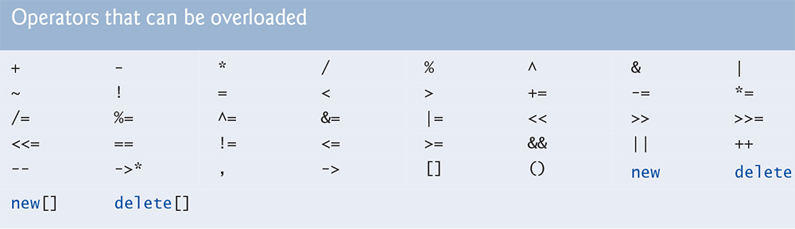
C++ operators

Slide 25


Slide 26
Number of Arguments for operator overloading function
Non Member function
The number of parameters equal number of operands for that operator
Member functions
The number of arguments are one less than the number of operands for that operator, since one operand is the calling object
Notes:
Robert Lafore, page 330, 4th Ed
In class Distance the declaration for the operator+() function looks like this:
Distance operator + ( Distance );
This function has a return type of Distance, and takes one argument of type Distance.
In expressions like
dist3 = dist1 + dist2;
it’s important to understand how the return value and arguments of the operator relate to the
objects. When the compiler sees this expression it looks at the argument types, and finding
only type Distance, it realizes it must use the Distance member function operator+(). But
what does this function use as its argument—dist1 or dist2? And doesn’t it need two arguments,
since there are two numbers to be added?
Here’s the key: The argument on the left side of the operator (dist1 in this case) is the object
of which the operator is a member. The object on the right side of the operator (dist2) must
be furnished as an argument to the operator. The operator returns a value, which can be assigned or used in other ways; in this case it is assigned to dist3. Figure 8.2 shows how this looks.
In the operator+() function, the left operand is accessed directly—since this is the object of
which the operator is a member—using feet and inches. The right operand is accessed as the
function’s argument, as d2.feet and d2.inches.

Slide 27
[ ] array index operator
There is no logical operation we would like to perform with this operaor on Distance class, so wait for the next example
++ and –- (Increment & Decrement operators)
There are two cases to be dealt with
Post increment/decrement
Pre increment/decrement

Slide 28
++, --
Lets continue with Distance class
what logic should be programmed for increment and decrement ??
Number of paramenters ??
What return type of the function should be ??
Lets first revise the use of these operators with integers
int a = 5, b=10;
b++;
b = a++;
++b;
b = ++a;

Slide 29
Reference
With reference, a new name or alias is created for an existing variable
A reference must be initialized at the time of declaration
int a=5;
int &b = a;
b++;
cout<<a;

Slide 30
Pass by Value and Pass by Reference
void f(int n)
{
n++;
}
int main()
{
int x = 2;
f(x);
cout << x;
}
void f(int &n)
{
n++;
}
int main()
{
int x = 2;
f(x);
cout << x;
}

Slide 31
Pre Increment/Decrement Operator

Slide 32
Post Increment/Decrement Operator
int parameter is a dummy one, and its purpose is just to differentiate between the pre increment and post increment

Slide 33
Example
Lets take an example, where we can add (concatenate) two strings
class mystring
{
char arr[50];
public:
mystring(){arr = “”;};
mystring(char a[])
{strcpy(arr,a);}
void dispStr(){cout<<arr;}
};
int main()
{
mystring str1("programming");
mystring str2(" for engineers");
mystring str3;
str3 = str1+str2;
str3.dispStr();
return 0;
}

Slide 34
Example
Lets now add (concatenate) them using ‘+’ operator
int main()
{
mystring str1("programming");
mystring str2(" for engineers");
mystring str3;
str3 = str1 + str2;
cout << str3;
cout << str3[1]
str3[2] = ‘z’;
str3.dispStr();
return 0;
}

Slide 35
Example
mystring mystring::operator+(mystring b)
{
strcat(arr,b.arr);
return *this:
//mystring temp(arr);
//return temp;
}

Slide 36
mystring class
Overloading other operators
> , < , ==
bool operator==(mystring b)
{
if(strcmp(arr, b.arr)==0)
return 1;
else return 0;
}

Slide 37
Overloading [] operator
char& mystring::operator[](int i)
{
return arr[i];
}

Slide 38
Multiple overloading functions for same operators
A program with different classes, with each class overloading the same operator, e.g., ‘+’ will have no problem in its working
Based on the type of operand, the relevant operator overloaded function will be called in to action.

Slide 39
Related topics
Member vs non-member operator overloading
friend function

Slide 40
Standard Library string class
#include <string>
Standard class of C++
It contains number of constructors, functions, and overloaded operator functions

Slide 41
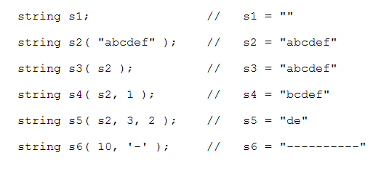
string Constructors
Notes:
http://pages.cs.wisc.edu/~cs368-2/CppTutorial/NOTES/STRING.html

Slide 42
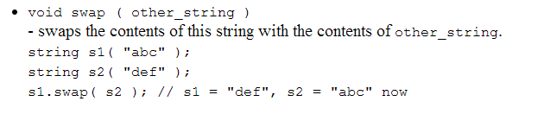


Member functions

Slide 43
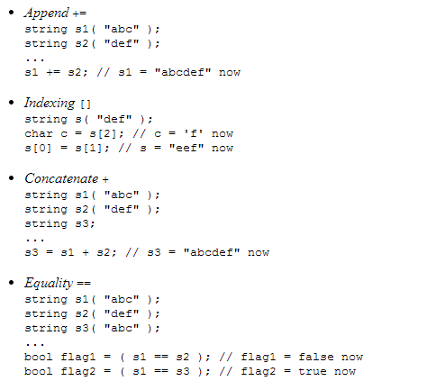
Overloaded Operators

Slide 44
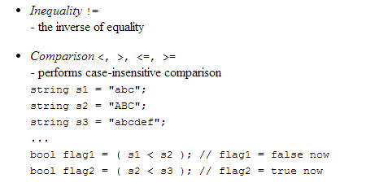
Overloaded Operators

Slide 45
References
Operator Overloading
Lafore Chp8(8.1 and 8.2) till page 343
Standard String class
http://pages.cs.wisc.edu/~cs368-2/CppTutorial/NOTES/STRING.html

